Slide 1
ATC
Artist Trading Cards
ACEO
Art Cards, Editions, and Originals

Slide 2
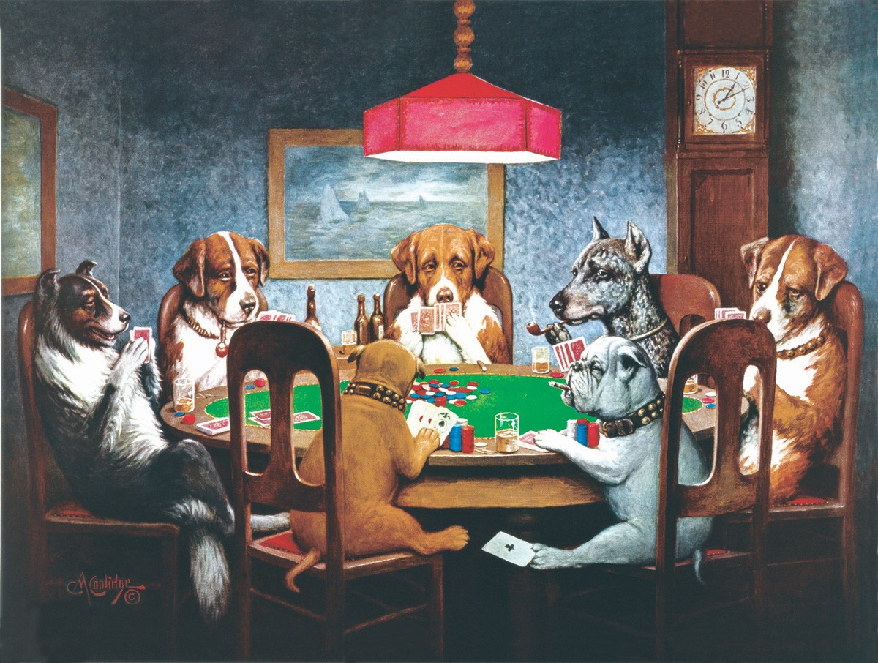

Slide 3
Basic History of ATCs
Zurich artist M.Vänçi Stirnemann visited Calgary in 1988
met with a group of adults participating in the Canadian activity of Trading hockey cards
Having only seen children collecting and trading cards
the idea of grown adults caring so much about the cardboard rectangles intrigued him greatly.

Slide 4
Inspired, he created and showcases over a thousand Artist Trading Cards in a gallery in Switzerland in 1997.
He refused to sell the cards but offered to swap with anyone who brought in a card.
A movement was born!!
Since 1997 hundreds people from all over the world have traded ATCs during trading sessions, or through the mail.

Slide 5
But what is an ATC?
miniature works of art
2 ½ X 3 ½ inch (64 X 89 mm)
originals, small editions and, most importantly, self-produced.
ATCs mustn't be sold, only exchanged
about artists meeting (by correspondence if in person meeting is not possible)

Slide 6
There should be no criticism of other artists' work.
When we encourage each other we all grow as artists.
The idea is to meet other artists
and share ideas, techniques and fellowship.

Slide 7
On the back of each ATC the artist writes part or all of the following information:
Name
Title of the ATC number (1/8, 2/8...) if it's part of an edition
Unique ATCs are called originals
sets of identical ATCs are called editions and are numbered; sets of ATCs that are based on one theme but that are different are called a series.

Slide 8
What can I use as the base for my ATC?
As long as the finished ATC can fit into the little plastic sleeves for storing Sports Trading cards, anything goes
Paper
Wood
Fabric
Cardboard
Photo paper
etc. etc. etc.

Slide 9
What techniques can I use?
Anything goes!
Drawing Painting
Printmaking Sewing
Metal tooling Collage
Rubber stamping Transfers
Mixed media Gelli printing
Digital media
etc. etc. etc.!

Slide 10
Ideas, Examples,
and Inspiration

Slide 11
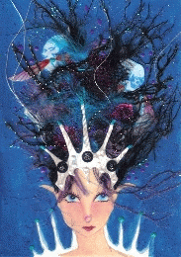

Slide 13
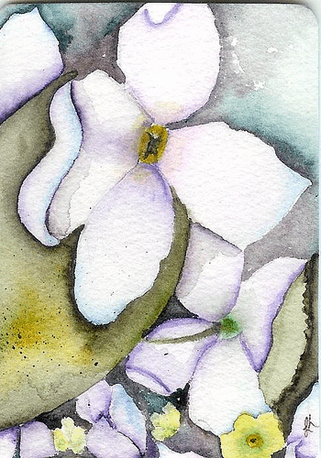
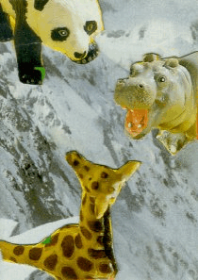

Slide 14
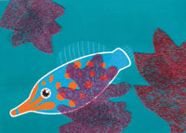

Slide 15
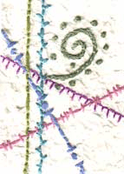
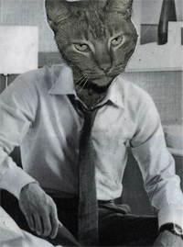

Slide 16
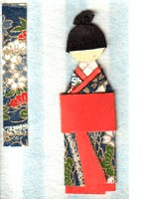
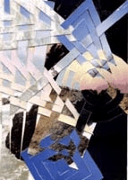

Slide 17
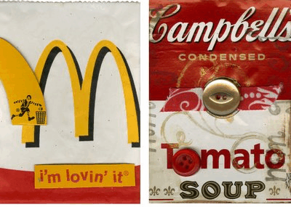
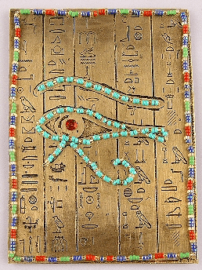

Slide 18
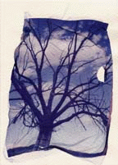
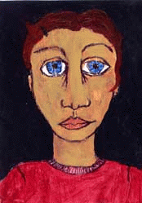
Leakarts

Slide 19
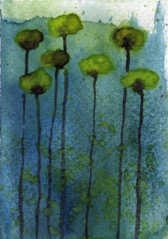

Slide 20
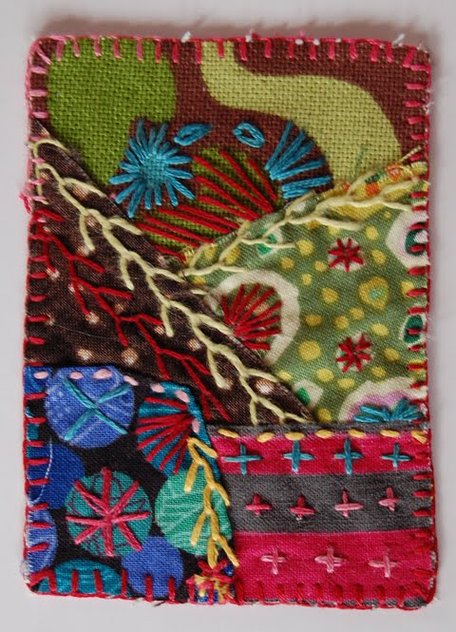

Slide 21
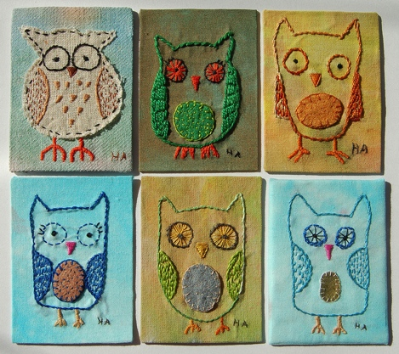
Hanna Andersson

Slide 22
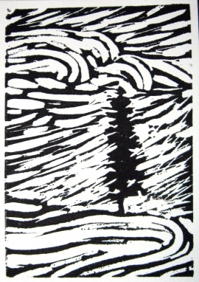

Slide 23
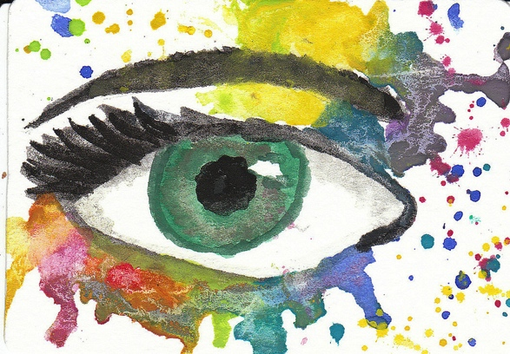
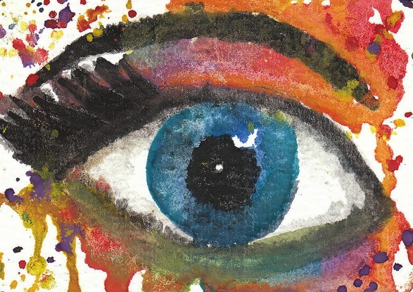
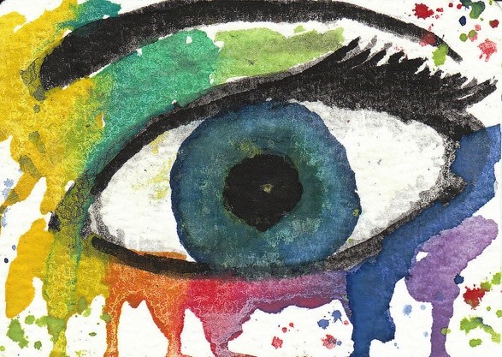
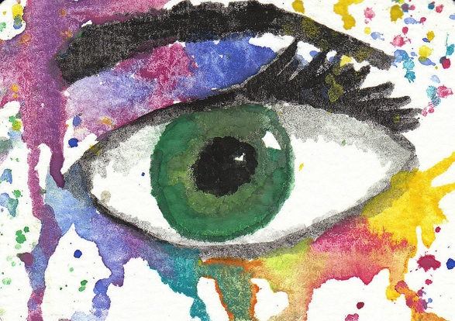
SanDee 1899

Slide 25
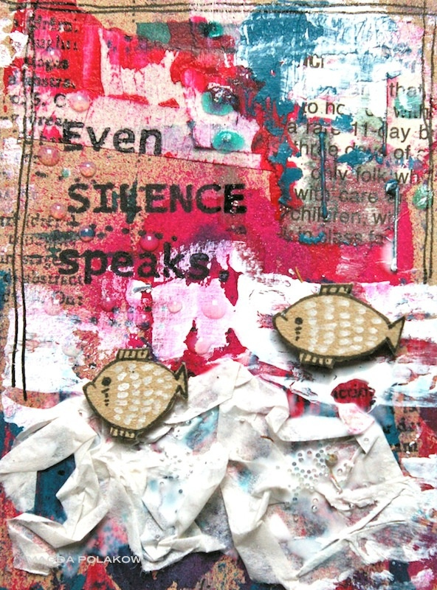
Magda Polakow

Slide 26
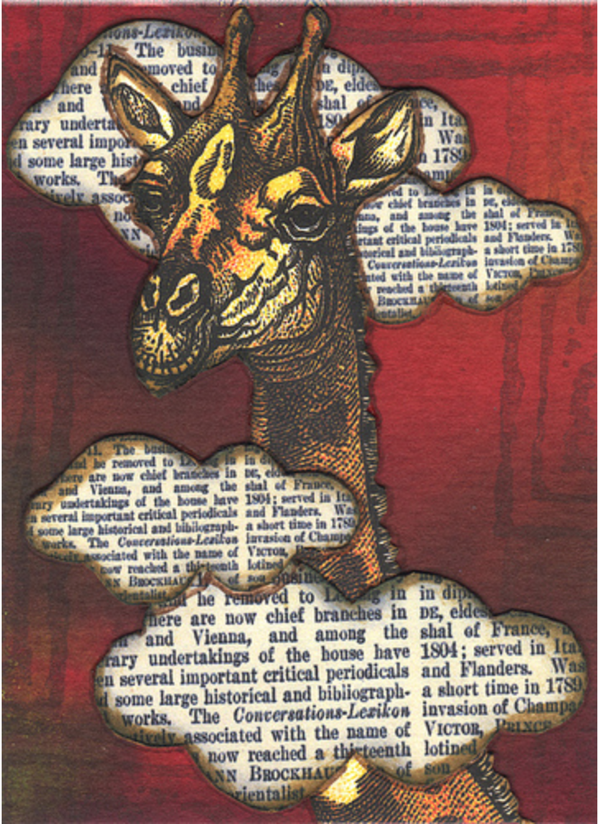

Slide 27
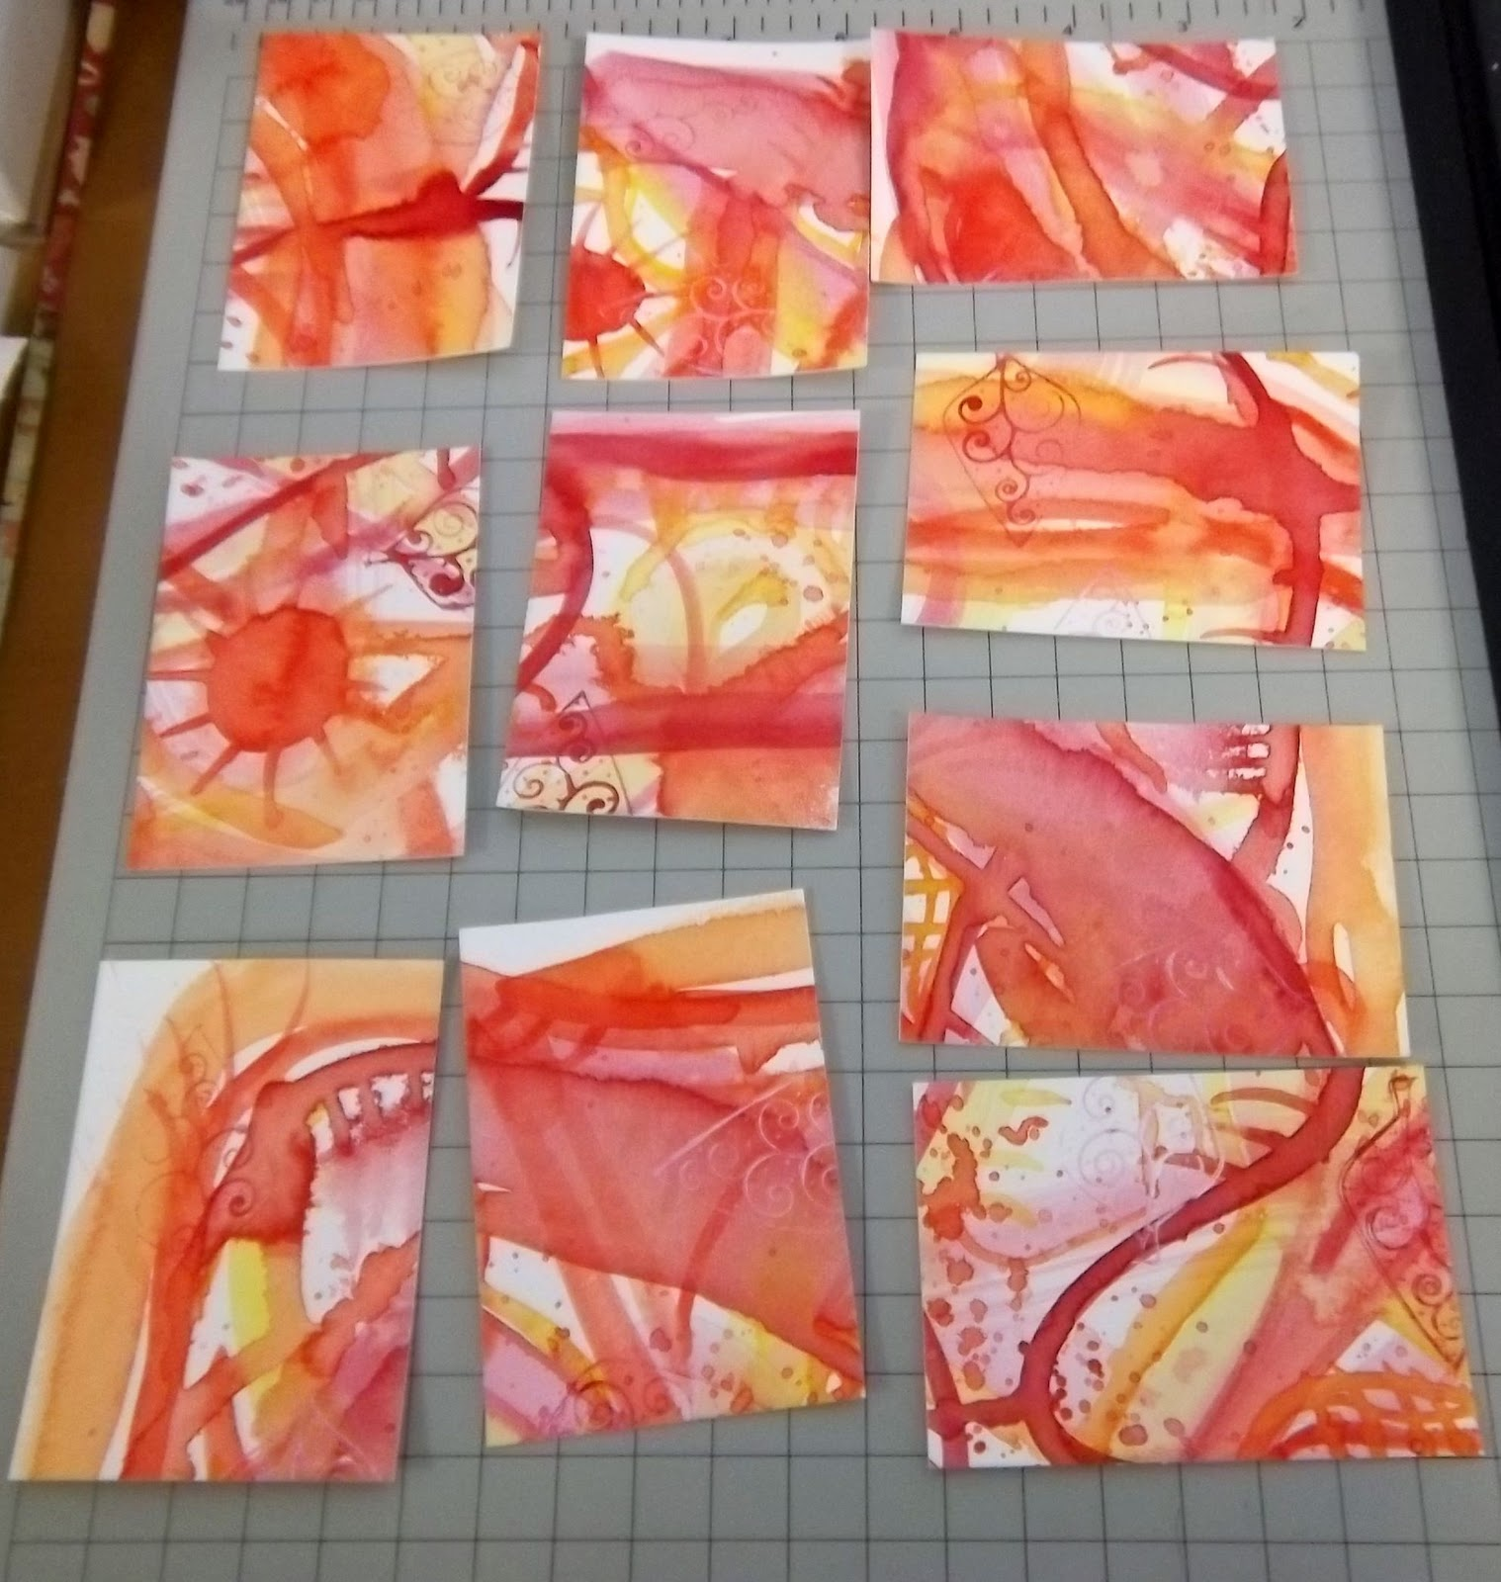

Slide 28
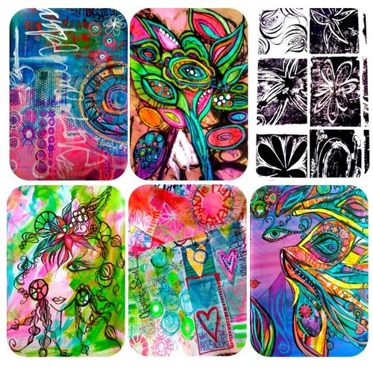
Creativity Unleashed http://kollaj.typepad.com/kollaj/

Slide 29
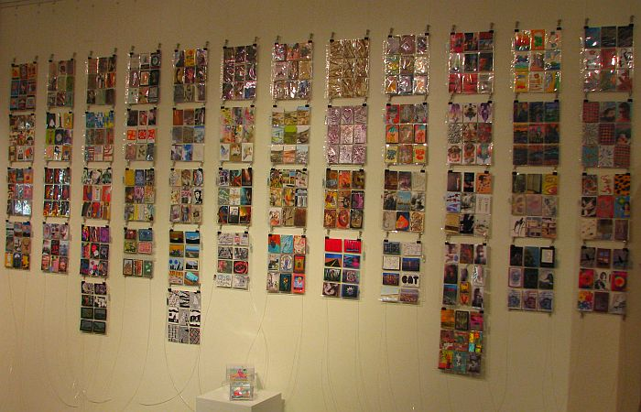

Slide 30
