Slide 1
Mary and the Saints

Slide 2
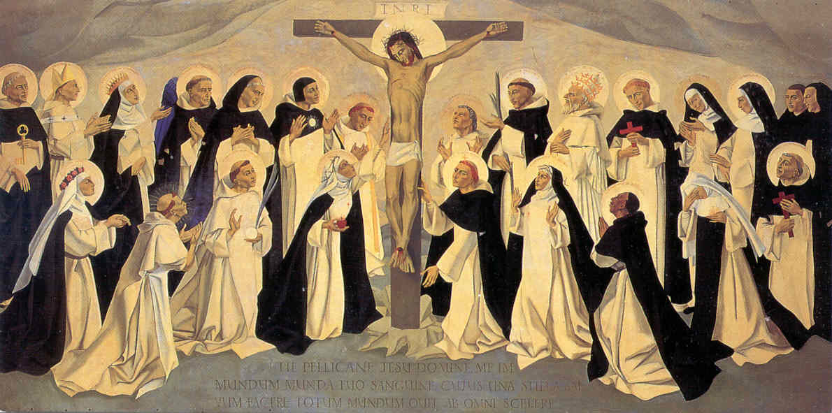
What is a Saint?
The word “Saint,” means holy.
A Saint is a person who lives their life in a holy manner and for God.
Notes:
Ask student:
What do you think it means to be holy?

Slide 3
How are Saints chosen?
In order for a holy person to become a Saint in the Catholic church, they must be canonized.
Canonization is the process that someone goes through to become a Saint
There are 5 steps to canonization.
Notes:
Explain to students:
- The difference between canonization and canonized is that canonization is the process for someone to become a Saint, and canonized means they have become a Saint.

Slide 4
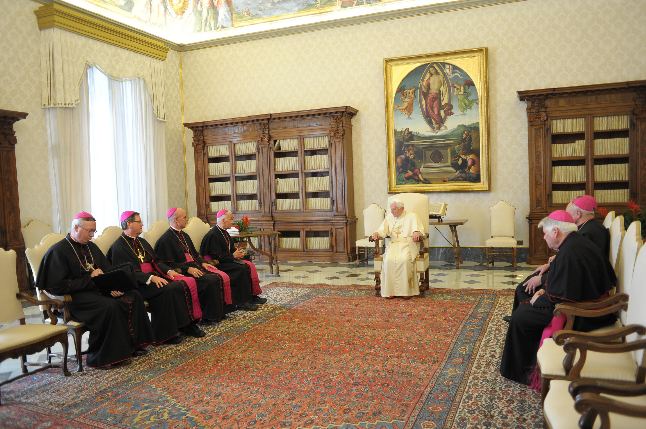
Canonization
Step 1: The holy person dies and the local bishop investigates their life and any Catholic writings
Step 2: A panel of theologians then evaluate the holy person at the Vatican.
Notes:
Ask students:
What do you think a theologian is?
Explain to students:
- A theologian is a person who is an expert on studying Catholicism and studies God. Comes from Greek word “theos” which means God, and ology is the study of. Therefore: the study of God.

Slide 5
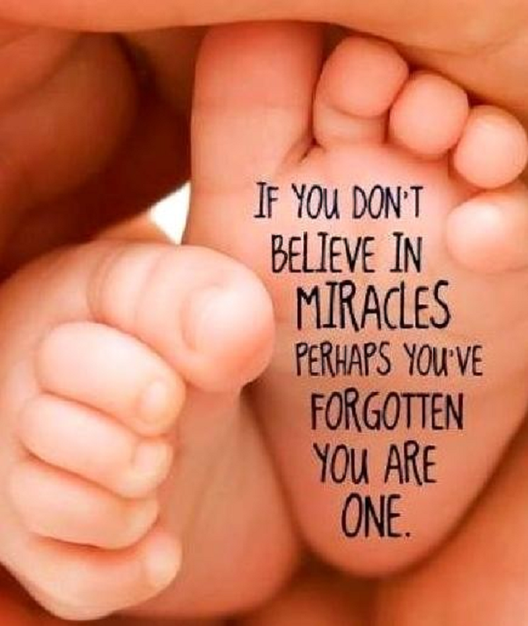
Canonization
Step 3: The holy person is proclaimed “venerable” after the conference.
Step 4: The person becomes beatified and must provide one miracle that is specifically asked of them.
Step 5: After one more miracle, the person will be canonized and becomes a Saint.
Notes:
Explain to students:
Venerable means that the person is seen as holy and respected in the Catholic Church but they are not yet Saints
Beatification is not canonization, it is the step before canonization where the potential Saint must perform a miracle.
Becoming a Saint does not mean that the Church has declared them a Saint, it means that the church recognizes what God has already done.

Slide 6
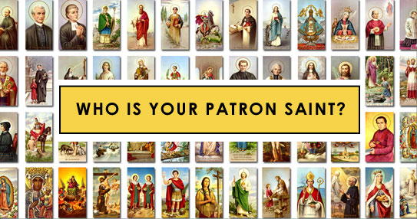
Fun Facts about Saints:
Saints have feast days! There are calendar days in the year that celebrate Saints.
Saints are Patrons of things or places. This is why we use intercessory prayer to pray to God. We do not pray to the Saints, we pray with the Saints.
Notes:
Ask students:
If they know anything else about Saints
Explain:
Being a patron saint means protecting/watching over certain places or things
Explain that intercessory prayer means asking a Saint or holy being to pray with you to God for petitions. For example praying with St. Gertrude of Nivelles to God for the petition of healing your cat. (St. Getrude of Nivelles is the Patron Saint of Cats)

Slide 7
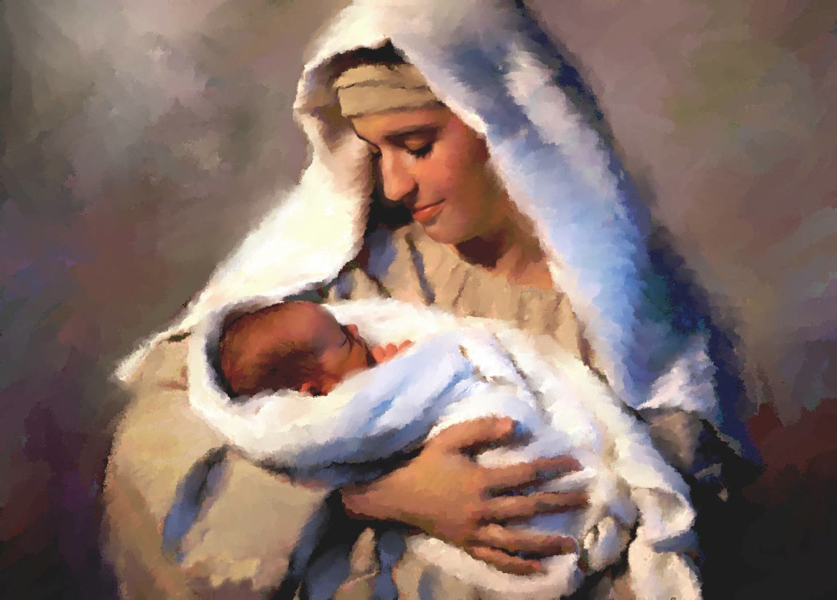
What about Mary?
Mary is an example to all of us who wish to become Saints/have become Saints.
Mary is one of the most selfless people in history and dedicated her life to God when she said yes to his call.
Notes:
Ask students:
What did God call Mary to do? (Recall)
How can we be like Mary and be selfless in our daily lives?
Explain:
A person who is holy lives their lives for God just as Mary did. Mary did everything in her life with devotion and dedication to God and to Jesus. She willingly accepted God’s calling and became the mother of Jesus. Mary went through many hardships when she became Jesus’ mother, but continued to believe, and pray in God.
Now Mary is seen as the ultimate example of how we should live our lives in dedication to God.

Slide 8
Resources:
Catholic Online. "Frequently Asked Questions about Saints - Saints & Angels - Catholic Online." Frequently Asked Questions about Saints - Saints & Angels - Catholic Online. Catholic Online, 2013. Web. 27 July 2014.

